Slide 1
Logistic Regression (LR)
Ankit Jain

Slide 2
When and Why of LR
To predict an outcome variable that is categorical from predictor variables that are continuous and/or categorical
Used because having a categorical outcome variable violates the assumption of linearity in normal regression
The only “real” limitation for logistic regression is that the outcome variable must be discrete

Slide 3
Some Applications
Healthcare: Risk of a disease
Engineering: Product, system etc. failure modeling
Marketing: Propensity modeling
Logistics: Predicting the churn of drivers
Ad Industry: Click through rate prediction
Basically anywhere where getting a good probability estimate is of high importance or model needs to be updated in real time

Slide 4
Types of Logistic Regression
Binary LR:
Dependent variable is binary
Multinomial LR:
Dependent variable is discrete but not binary
Ordinal LR:
Dependent variable with multiple categories which are ordered

Slide 5
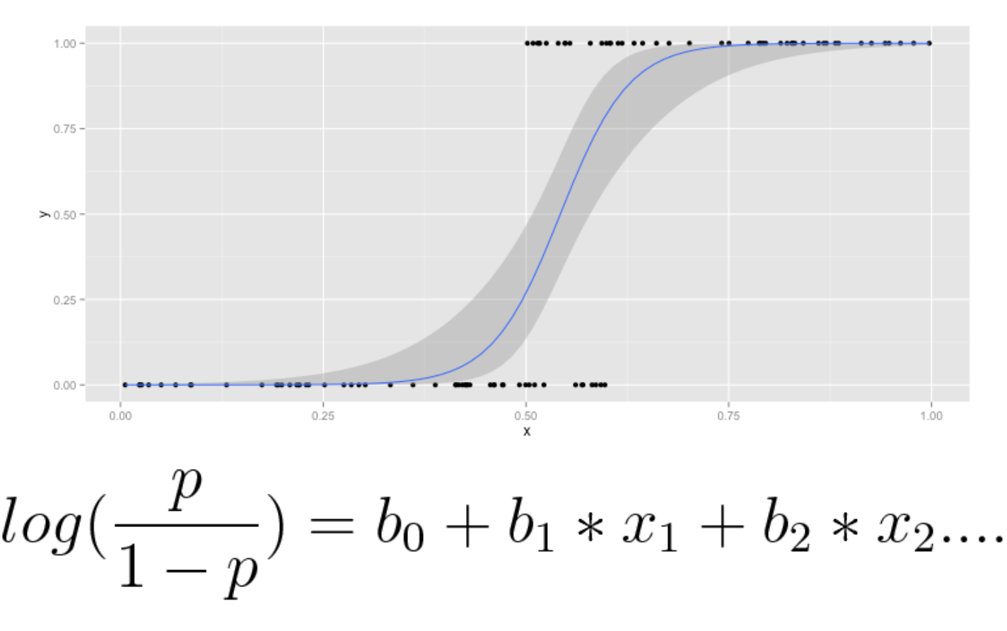
Mathematical Formulation
p denotes the probability of a dependent variable
X’s denote the IDV
DV is known as log odds ratio

Slide 6
Maximum Likelihood Estimation
One difference from linear regression here is that we are not trying to accurately predict log(p/1-p) here. That is the reason we don’t usual regression techniques here
What we want to achieve here is the maximum separation between 1s and 0s
For this reason, we use ML estimation and estimate the parameters using gradient descent

Slide 7
Interpreting Odds Ratio
Odd = P/(1-P)
The odd of success is defined as ratio of probability of success to probability of failure
If p is equal to 0.8, then the above equation becomes
Odd = 0.8/0.2 = 4
The odd is 4 which means that odd of success is 4 to 1
Logistic regression gives log odd. If the β1 value is 1.6, it means that 1 unit change in X1 while others independent variables are at same level, produces 1.6 unit change in log of the odd
In other words, the chances of success over chances of failure are increased by exp(1.6)

Slide 8
Assumptions of LR
No assumption on linear relationship between dependent and independent
Absence of multicollinearity
Independence of error terms
No assumption on homoscedasticity and distribution of error term.
Decent number of training samples for each category

Slide 9
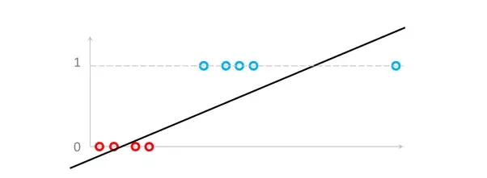
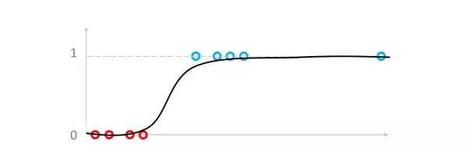
Effect of Outliers on Linear Regression
Linear Regression
Logistic Regression
Overall logistic regression is less affected by outliers as compared to linear regression

Slide 10
Feature Scaling in LR
We can rescale the variables in a regression model in order to help the others better comprehend the potential meaning of regression coefficients.
Rescaling a predictor in a regression has absolutely no effect on the magnitude of the relation being studied—the slope itself will not change its steepness, nor will the p-values or variance explained be changed.
Rescaling is merely a means of communicating the nature of the regression line in different, hopefully more intuitive language.
In some cases, it also helps in converging to the solution faster with gradient descent

Slide 11
Model Evaluation
We generally decide cutoff to come up with the binary outcome of the variable
Accuracy of the model can be decided based on several criteria.

Slide 12
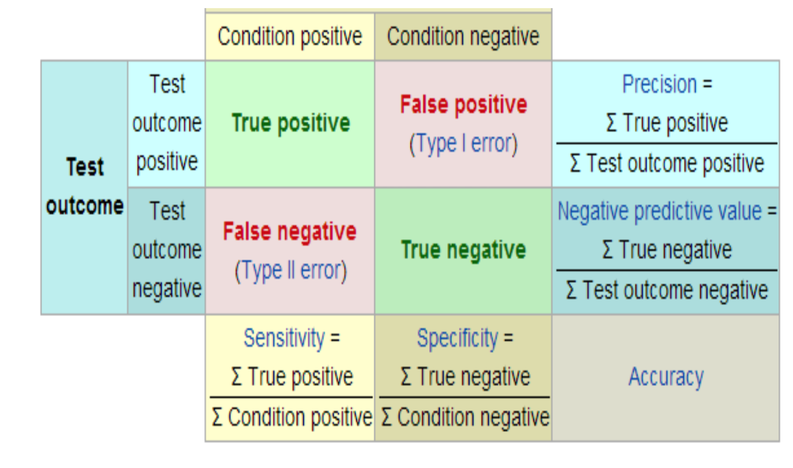
Model Evaluation

Slide 13
Practical Advantages of LR
Easier to productionize and train
Slower than Naive Bayes but can take advantage of correlated dependent variables
Doesn’t model non-linearity as well as Random Forests, SVM.
Can do online learning
Good probability interpretation

